Slide 1
Student Services Course

Slide 2
Main topics
Introduction – Understanding and building an effective and sustainable support system in HEI
Guidelines of effective mentoring
Supportive intervention and drop-out prevention
Methodology of handling students of HEI in the 21st century
Adaptability, online mentoring and follow-up

Slide 3
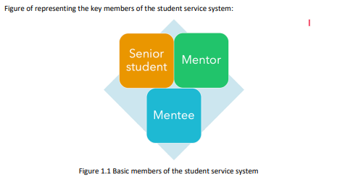

Slide 4
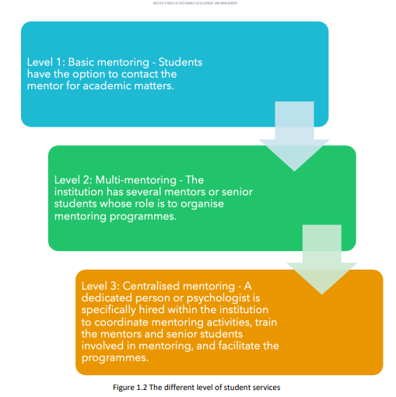

Slide 5
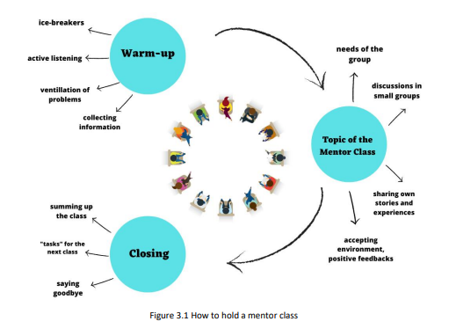

Slide 6
